Slide 1
Week 5 Lecture Plan:
Weighted Networks
Directed Networks
Bipartite Networks
Affiliation Networks

Slide 2
Weighted Networks

Slide 3
“The weight reflects the power of connection”
A
W=2
B
W=4
C
or amount
or repeat
or any numeric value

Slide 4
Weighted Networks
Think about this network:
A has a 1$ contract with B
B has a 3$ contract with C
C has a 5$ contract with A
B
1$
3$
A
C
5$
Node 1 | Node 2 | Amount
A | B | 1
B | C | 3
C | A | 5
Notes:
Weight reflects power or amount
We can visualize it by line thicnkesss
We tabularize by third column

Slide 5
Importing weighted networks from text file
df = read.csv("../data/weighted.csv")
library(igraph)
G = graph.data.frame(df,directed = FALSE)
G <- set_edge_attr(G, "weight", value= df$amount)
Node 1 | Node 2 | Amount
A | B | 1
B | C | 3
C | A | 5

Slide 6
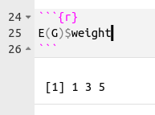
Is my graph object weighted?
is_weighted(G)
True
False

Slide 7
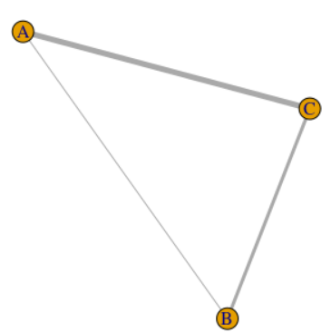
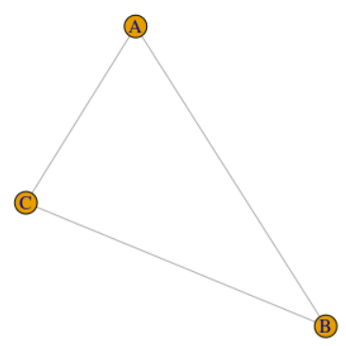
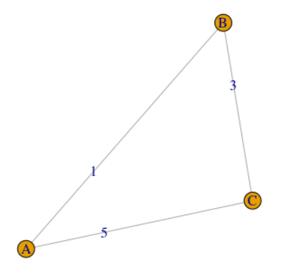
Visualizing the weights
plot(G,edge.label=E(G)$weight))
E(G)$width <- E(G)$weight
plot(G)
plot(G)

Slide 8
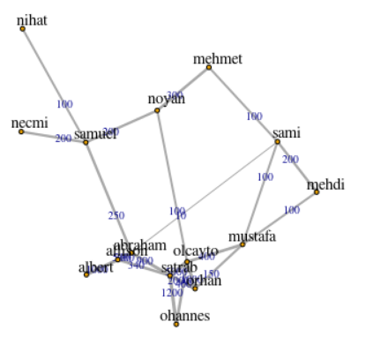
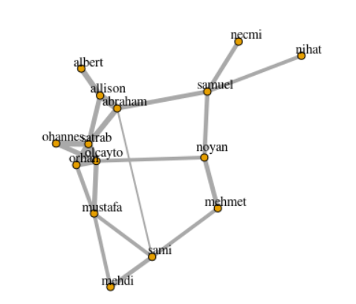
Visualizing Larger Weighted Networks
E(G)$width <- log10(E(G)$weight)
Notes:
Overlapping problem
Normalization with log or other operator

Slide 9
Do not try to visualize everything except the things that matter!

Slide 10
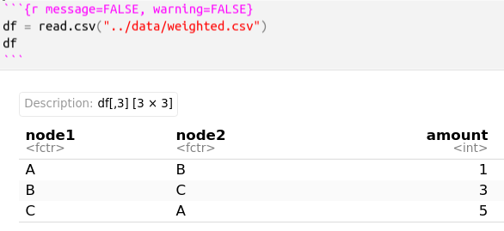
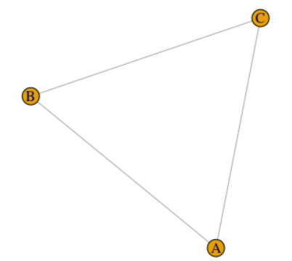
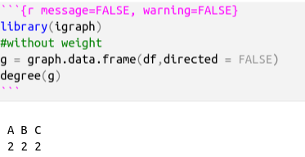
Degree Centrality in Weighted Networks
Notes:
Define degree cnt.

Slide 11
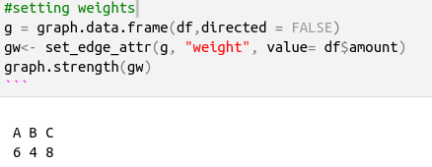
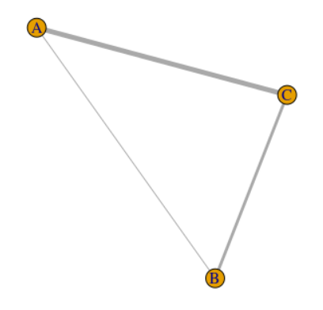
Degree Centrality in Weighted Networks
Sum of weights for each node= Graph Strength
A = 1+5 = 6, B = 1 + 4 = 4, C= 3 + 5 = 8
graph.strength(gw)
degree(g)
Weighted version of degree centrality

Slide 12
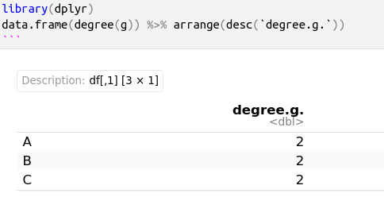
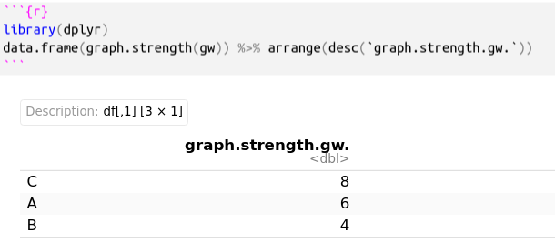
Comparison of Graph Strength vs. Degree
Notes:
Weights are matters

Slide 13
The “weight” or power of any connection affects the total power of any node

Slide 14
Directed Networks

Slide 15
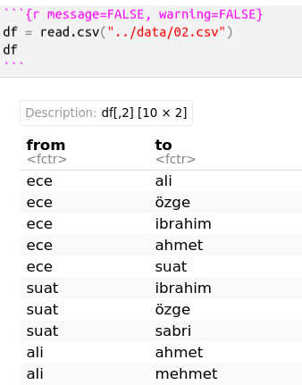
Directed Graphs
Notes:
we said from to but it is not required

Slide 16
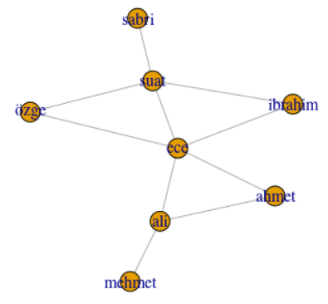
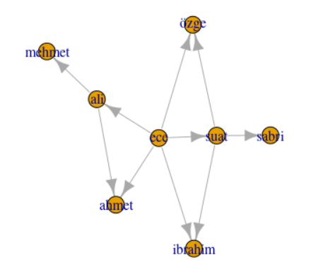
Directed vs. undirected

Slide 17
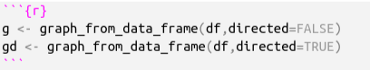
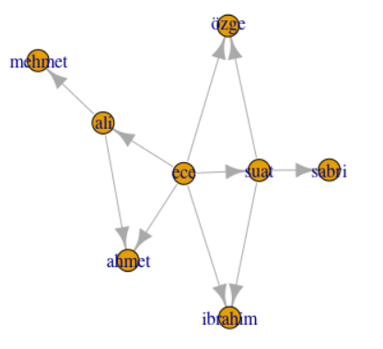
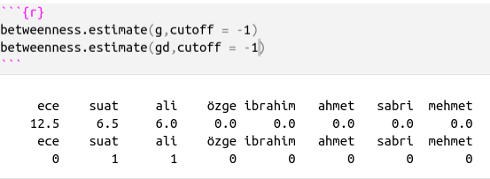
Betweenness Centrality for Directed Graphs
Notes:
In graph theory, betweenness centrality (or "betweeness centrality") is a measure of centrality in a graph based on shortest paths. ... For example, in a telecommunications network, a node with higher betweenness centrality would have more control over the network, because more information will pass through that node.

Slide 18
Some network measures works differently for directed and undirected networks.
Degree centrality is the same for directed and undirected networks.
Betweenness centrality works depend the direction.

Slide 19
Bipartite Networks

Slide 20
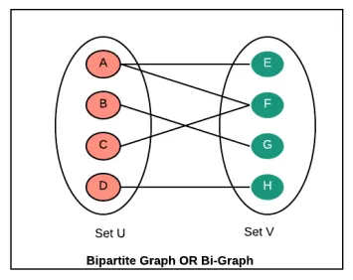
Bipartite Networks
A bipartite network contains two kinds of vertices and connections are only possible between two vertices of different kind.
There are many natural examples, e.g. movies and actors as vertices and a movie is connected to all participating actors, etc.
Notes:
In affiliation networks, there are always two types of nodes: one type for the actors,
and another type for the groups or events to which the actors belong. Ties then
connect the actors to those groups. One consequence of this is that there are no direct
ties among actors, and there are no direct ties between the groups.

Slide 21
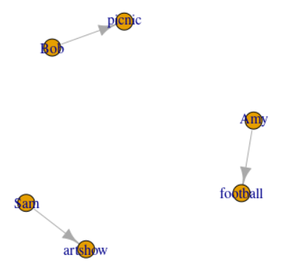
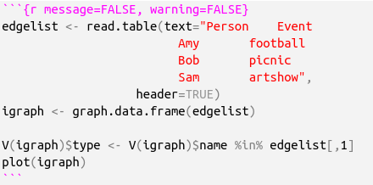
Bipartite Networks with igraph
Notes:
Explains nothing

Slide 22
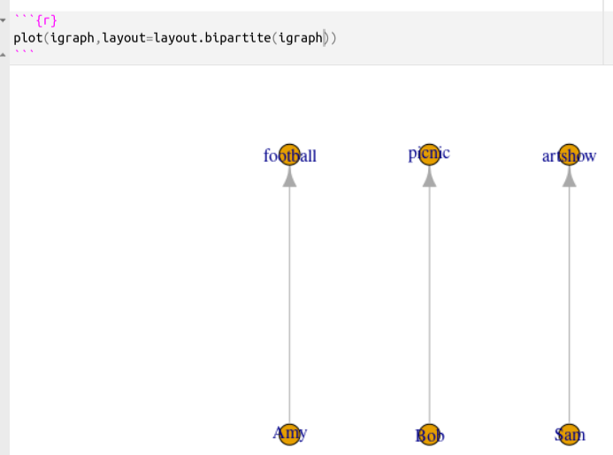
Plotting the bipartite networks

Slide 23
Real World Example: Ecology
Many interactions between species are between distinct groups, such as pollinators and flowers, or herbivores and plants, or parasitoids and their hosts, or predators and their prey. When no information on interactions within groups is known, we have the case of a bipartite (a.k.a. “two-mode”) network
https://cran.r-project.org/web/packages/bipartite/vignettes/Intro2bipartite.pdf
library(bipartite)
par(xpd=T)
plotweb(motten1982)

Slide 24
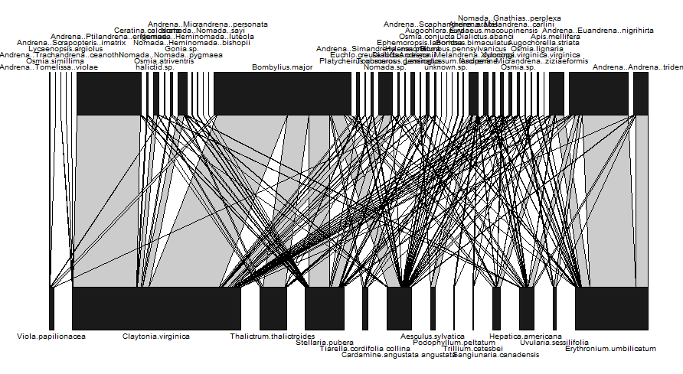
Relation between the species

Slide 25
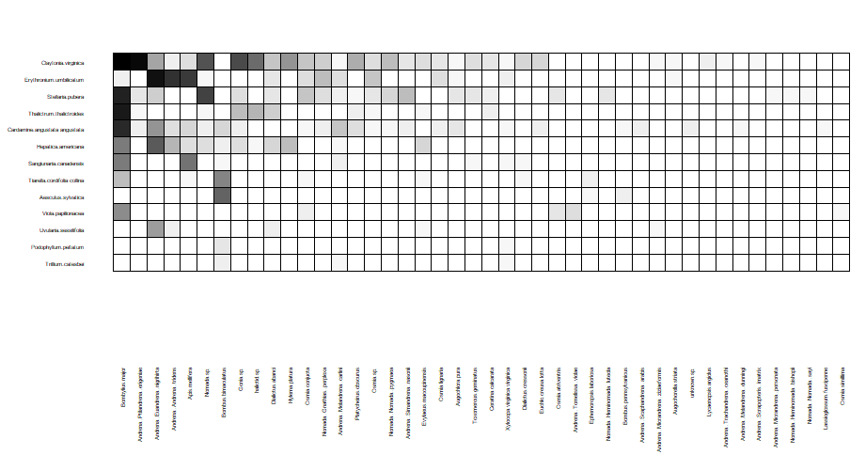
visweb(motten1982) / Heatmap for bipartite graphs

Slide 26
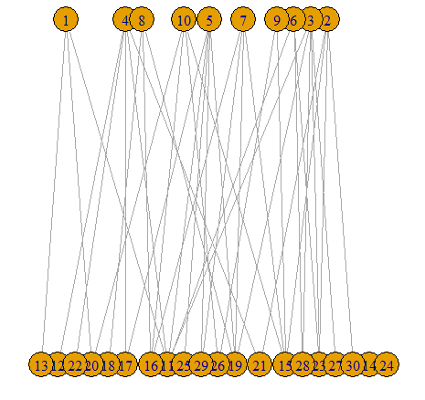
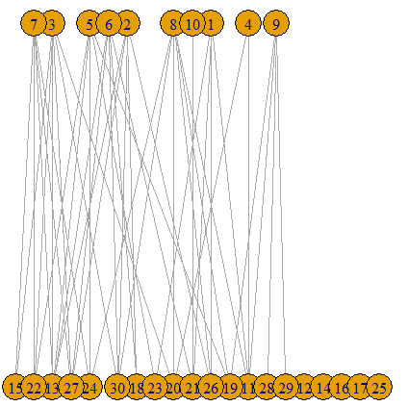
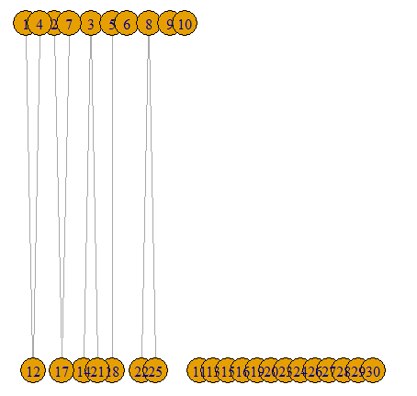
Random Bipartite Graphs
bp <-bipartite.random.game(10,20,p = 1/20)
plot(bp,layout=layout.bipartite(bp))
bp <-bipartite.random.game(10,20,p = 1/5)
plot(bp,layout=layout.bipartite(bp))

Slide 27
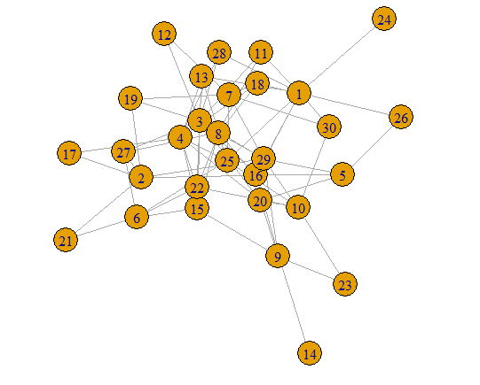
Is my graph bipartite?
Is this graph bipartite?
Answer: Yes
bp <-bipartite.random.game(10,20,p = 1/3)
plot(bp,layout=layout.fruchterman.reingold(bp))
Checking:
is_bipartite(bp)
TRUE

Slide 28
Checking the nature of the your network before the analysis is a good practise.

Slide 29
Cafe Example: Bipartite Graphs
library(igraph)
# Your matrix containing consumer choice by brands
m = matrix(data = sample(0:1, 25, replace = TRUE), nrow = 5, ncol = 5)
colnames(m) = c("Ezgi", "İbrahim", "Serkan", "Ece", "Ali")
rownames(m) = c("Costa", "Starbucks", "Cafe2U", "Tchibo", "Caribou Cafe")
# Convert it to a bipartitie network
bg = igraph::graph.incidence(m)
bg
# See the vertex attributes
V(bg)$type
V(bg)$name
# Plot the network
shape = ifelse(V(bg)$type, "circle", "square") # assign shape by node type
col = ifelse(V(bg)$type, "red", "yellow") # assign color by node type
plot(bg, vertex.shape = shape, vertex.color = col)

Slide 30
Cafe Example: Bipartite Graphs
library(igraph)
# Your matrix containing consumer choice by brands
m = matrix(data = sample(0:1, 25, replace = TRUE), nrow = 5, ncol = 5)
colnames(m) = c("Ezgi", "İbrahim", "Serkan", "Ece", "Ali")
rownames(m) = c("Costa", "Starbucks", "Cafe2U", "Tchibo", "Caribou Cafe")
# Convert it to a bipartitie network
bg = igraph::graph.incidence(m)
bg
# See the vertex attributes
V(bg)$type
V(bg)$name
# Plot the network
shape = ifelse(V(bg)$type, "circle", "square") # assign shape by node type
col = ifelse(V(bg)$type, "red", "yellow") # assign color by node type
plot(bg, vertex.shape = shape, vertex.color = col)

Slide 31
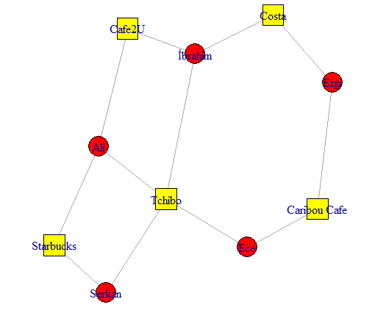
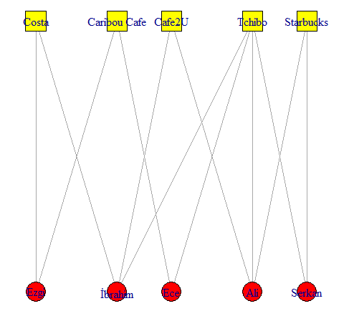
Cafe Example: Bipartite Graphs
plot(bg, vertex.shape = shape, vertex.color = col,layout=layout.bipartite(bg))

Slide 32
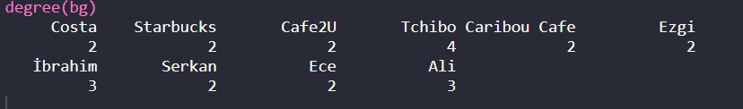
Interpreting degree centrality in the bipartite networks
Most popular cafe?
Most loyal persons?
Possibility of interactions among people?

Slide 33
Literature: Ingredient-flavor network
Yong-Yeol Ahn, Sebastian E. Ahnert, James P. Bagrow & Albert-László Barabási
Abstract
The cultural diversity of culinary practice, as illustrated by the variety of regional cuisines, raises the question of whether there are any general patterns that determine the ingredient combinations used in food today or principles that transcend individual tastes and recipes.
We introduce a flavor network that captures the flavor compounds shared by culinary ingredients.
Western cuisines show a tendency to use ingredient pairs that share many flavor compounds, supporting the so-called food pairing hypothesis.
By contrast, East Asian cuisines tend to avoid compound sharing ingredients.
Given the increasing availability of information on food preparation, our data-driven investigation opens new avenues towards a systematic understanding of culinary practice.

Slide 34
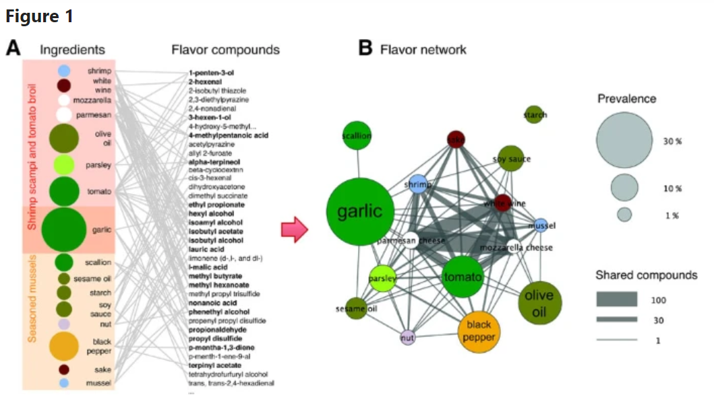
Literature: Ingredient-flavor network
Different cuisines
Shared tastes
Shared compounds
If we project the ingredient-compound bipartite network into the ingredient space, we obtain the flavor network, whose nodes are ingredients, linked if they share at least one flavor compound. The thickness of links represents the number of flavor compounds two ingredients share and the size of each circle corresponds to the prevalence of the ingredients in recipes.
https://www.nature.com/articles/srep00196

Slide 35
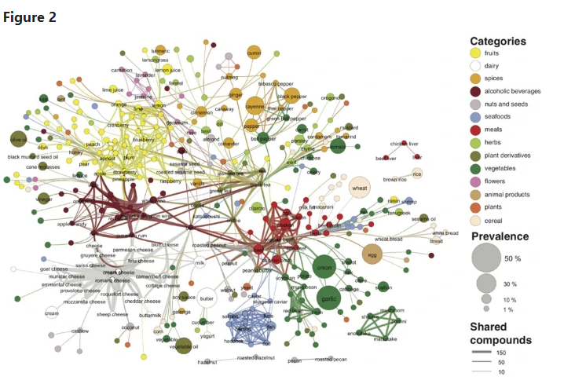
Literature: Ingredient-flavor network
Each node denotes an ingredient, the node color indicates food category and node size reflects the ingredient prevalence in recipes.
Two ingredients are connected if they share a significant number of flavor compounds, link thickness representing the number of shared compounds between the two ingredients
https://www.nature.com/articles/srep00196

Slide 36
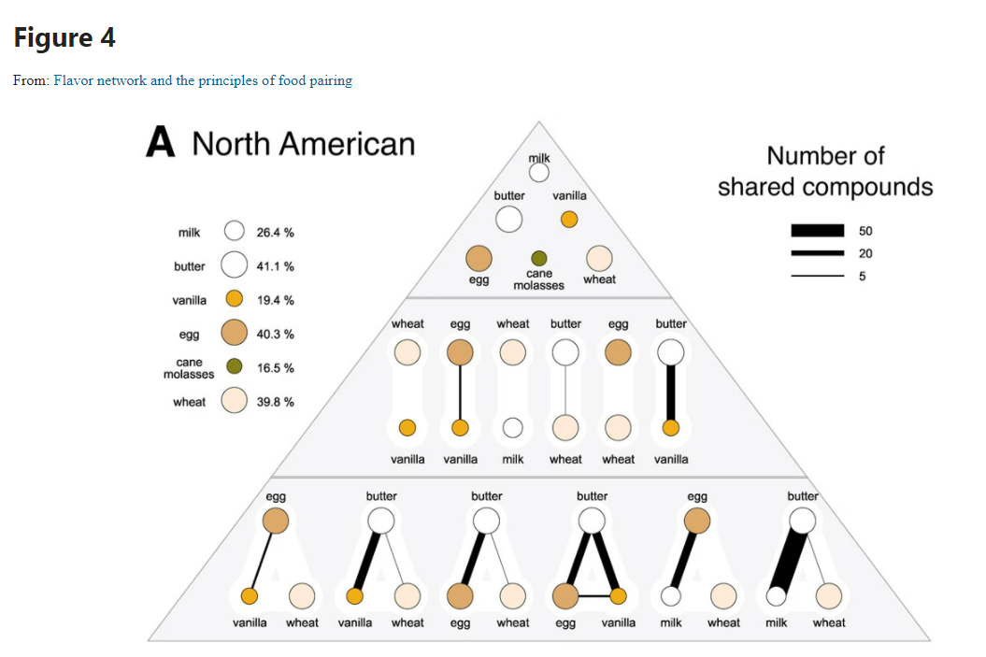
Map of ingredients
https://www.nature.com/articles/srep00196

Slide 37
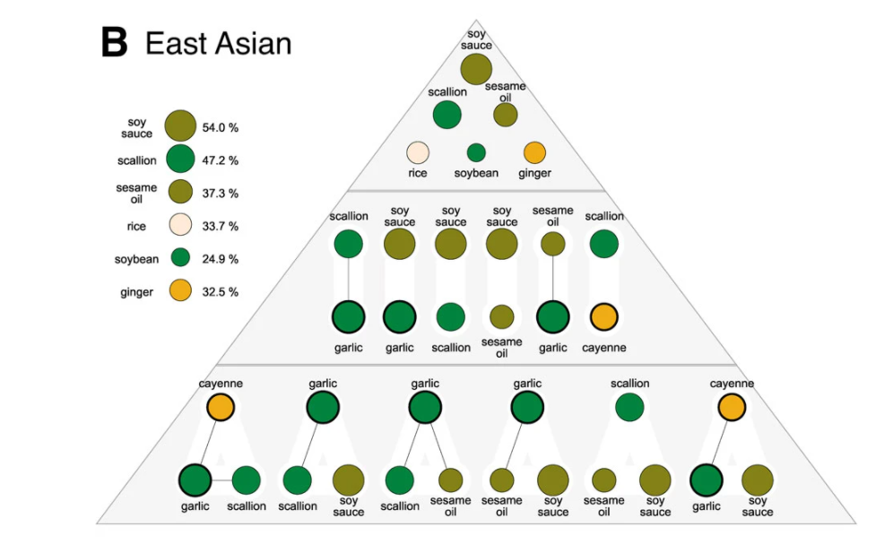
Map of ingredients
https://www.nature.com/articles/srep00196

Slide 38
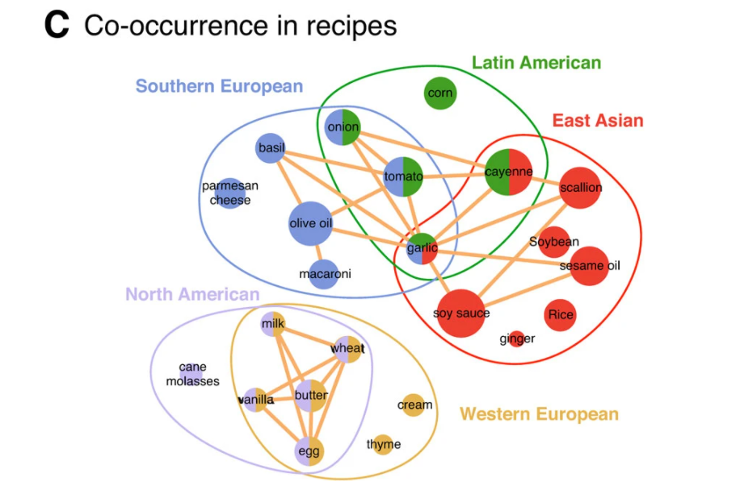
Map of ingredients
https://www.nature.com/articles/srep00196

Slide 39
Conclusions:
For instance, the French cookbook has more ingredients per recipe than a Brazillian one, but in our dataset we find the opposite result. We believe that a cookbook cannot represent a whole cuisine and that cookbooks with more sophisticated recipes will tend to have more ingredients per recipe than cookbooks with everyday recipes.
As more complete datasets become available, sharper conclusions can be drawn regarding the size variation between cuisines.
In summary, our network-based investigation identifies a series of statistically significant patterns that characterize the way humans choose the ingredients they combine in their food.
These patterns manifest themselves to varying degree in different geographic regions: while North American and Western European dishes tend to combine ingredients that share flavor compounds, East Asian cuisine avoids them. More generally this work provides an example of how the data-driven network analysis methods that have transformed biology and the social sciences in recent years can yield new insights in other areas, such as food science.

Slide 40
The End

